Slide 1
CAREY CITYLABS
Better Cities for a Better World
Collaborative Research, Practice, and Learning

Slide 2
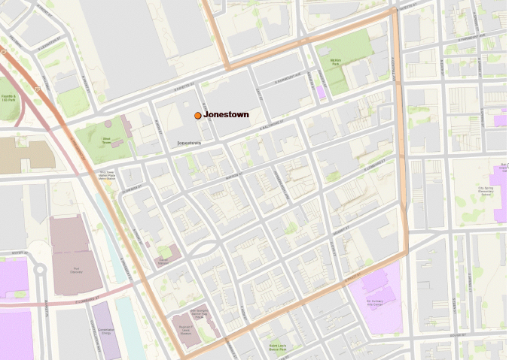
A Livable City
. . . a dynamic, flourishing ecocommunity of nature, places, people, institutions, cultures, and commerce that enables the present generation to realize their human capabilities without compromising future generations.

Slide 3
The City Challenge
Cities are the vital heart of human culture and commerce, producing most of the world’s wealth of ideas, technology, innovation. . .
. . . but . . .
. . . most of humanity lives in urban areas threatened by congestion, poverty, conflict, and environmental degradation that impede their ability to flourish and realize the full value of their potential.

Slide 4
The Competitive Challenge
Globalization, urbanization, and capital mobility intensify global resource competition among cities for vital urban infrastructure, services, and investment.
Much of the world’s wealth is mobile: Capital, intangibles, goods, products.
Cities are anchored in place.

Slide 5
Complex Challenges
How do underperforming urban neighborhoods prevent people and whole cities from realizing their full human, cultural, and economic value.
How can people reimagine their own cities and removed barriers to growth?
How can we prepare the next generation of business leaders to create solutions to these challenges?

Slide 6
The Baltimore Urban Challenge
Post-industrial cities like Baltimore are especially vulnerable in their limited capacity to generate and attract sufficient capital to fuel urban vitality.
How can Baltimore reinvent its business and commercial sector for the post-industrial era to grow its own next generation of Fortune 500 companies?

Slide 7
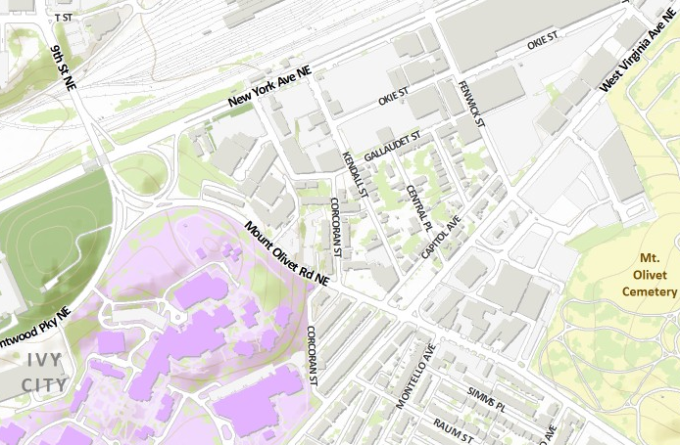
The DC Urban Challenge
Rapid gentrification and dense development have transformed the District, but its industrial corridor is neglected and undervalued.
How can DC revitalize its weak industrial sector to strengthen and diversify its economic base?

Slide 8
Megadevelopment is not Enough!
Big multinational companies and large scale projects create anchors of opportunity and wealth, but they cannot be sufficiently scaled to address the breadth and depth of urban challenges.
Most urban neighborhoods have to be the driving force in creating their own future.

Slide 9
Taking on the Challenge:
Carey CityLabs
A diverse, multi-sector collaboration of urban stakeholders sharing
knowledge, expertise, risk, and rewards
to reinvent distressed, undervalued neighborhoods as catalysts of wealth creation for human flourishing and better business for a better world.

Slide 10
CityLab
Partners
City Stakeholders
Social entrepreneurs
Business leaders
Government/public officials
Social/business investors
Citizens/Civic groups
NPOs/NGOs
Researchers
Carey/JHU/Faculty
Policy groups
Independent scholars
Think tanks
Students
Carey
JHU
MICA
Learning partners
BUILDING BETTER CITIES
Best Urban Development Practices
Active, Practice-based Learning
Socially Engaged Research

Slide 11
Building better cities through practice and policy solutions and professional development networks informed by academic knowledge and expertise
City Stakeholders

Slide 12
Building better cities by collaborating with knowledge, practice, and policy leaders in urban projects that create sustainable shared value and position them for success
Students

Slide 13
Building better cities by generating knowledge and expertise that contribute to solving problems and creating opportunities in undervalued, underperforming urban neighborhoods
Researchers

Slide 14
Two CityLabs
Baltimore Jonestown
DC “Ward 5 Works”
(Northeast Industrial Gateway)

Slide 15
Jonestown Village CityLab
BALTIMORE
Repositioning a historic downtown
HOPE VI neighborhood as a premier urban lifestyle village

Slide 16
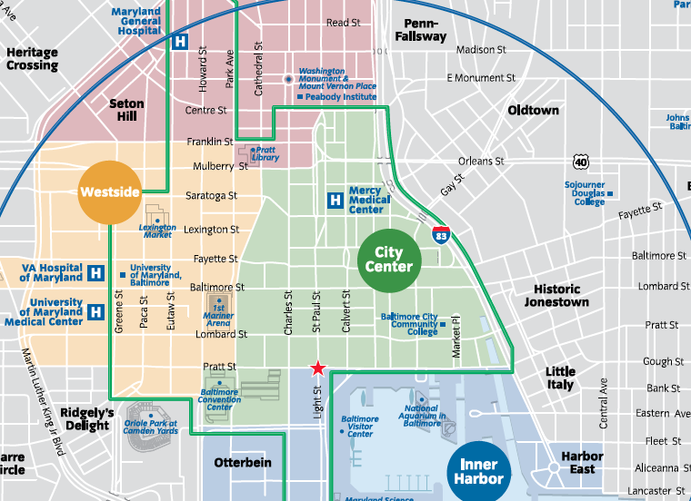

Slide 17
Downtown Baltimore Outlook
After 60 years of decline, Baltimore City population grew in 2012 – all downtown
Annual influx of 8,000 households for the next five years, >half from outside Baltimore City = 40,000 by 2017
Two-thirds younger singles/couples; one-fifth empty nesters
60% market rate rentals; 40% market rate homeowners

Slide 18
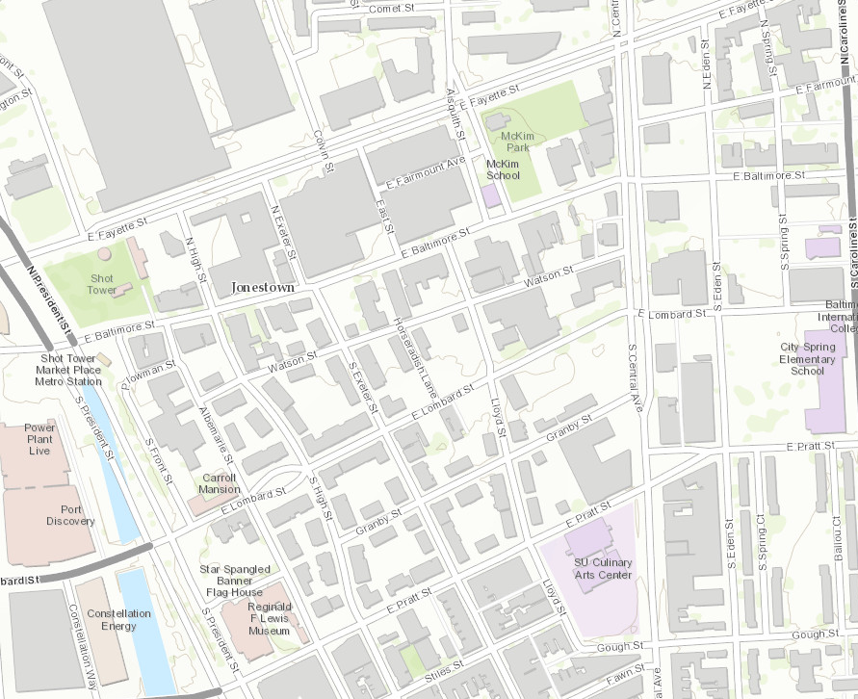
Jonestown Outlook
Poised to capture a
substantial share of
downtown Baltimore growth

Slide 19
Jonestown First Impressions
A “half-done” canvas of urban space:
“Invisible” neighborhood identity
Over 60 abandoned lots and buildings
Children playing in the street
Drab, littered, poorly lit streetscapes
Disconnected, undervalued destinations
Few places to eat, drink, hang out
Apathetic residents
Poorly tended residential properties
Sparse tree canopy and green space

Slide 20
A Second Look
High potential in undervalued assets:
A rich, curated historical/cultural legacy
Large tracts of undeveloped land
Engaged anchor institutions
Stable small business community
High potential for development
Free public transit circulators
Accessible to harbor area destinations
Resourceful community leaders

Slide 21
Jonestown Village 2020 Goals
Build an attractive, welcoming streetscape
Double residential population to 3000
Put vacant properties to productive use
Eliminate the food desert
Double neighborhood destination venues
Create an early childhood learning hub
Raise neighborhood per capita income
Double neighborhood jobs/business venues
Create job ladders out of poverty
Double aggregate property value

Slide 22
Jonestown CityLab Projects
  Jonestown Community Association
  Jonestown Master Plan
  Jonestown Central Commons
  Jonestown SkyFarm
  Jonestown KinderVillage/Early Learning Hub
  Jonestown MakerSpace
  Corned Beef Row
  Hendler Collaboration Café
  Jonestown Heritage Festival
City Springs School

Slide 23
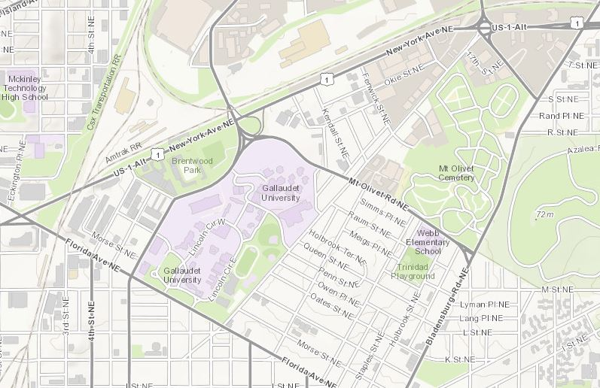
Ward 5 Works CityLab
WASHINGTON DC
Transforming a
neglected industrial zone into a vibrant New Economy hub

Slide 24
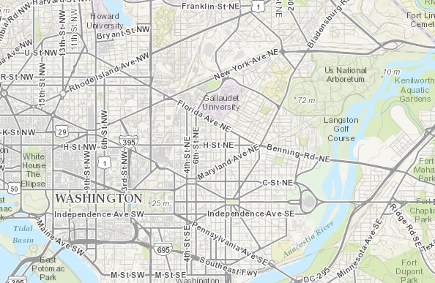

Slide 25
Washington DC Outlook
After decades of decline, DC is rebounding at a faster pace than most US cities
Public investments (education, transit, infrastructure) attract all demographics
Strong real estate growth (commercial, residential rental/condo)
Strong economic growth
Emerging as one of the country’s most livable cities

Slide 26
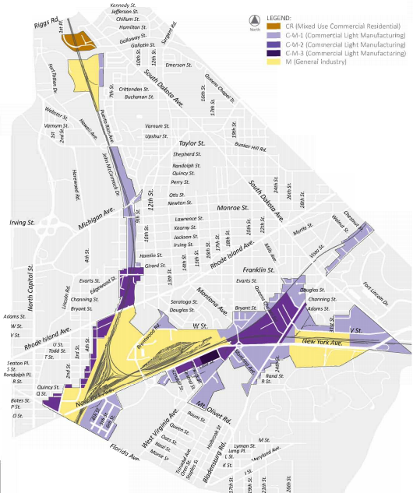
Ward 5 Works Outlook
Positioned to anchor the next wave of DC economic growth and industrial diversification

Slide 27
Ward 5 Gateway First Impressions
A drab, post-industrial urban wasteland:
“Invisible” neighborhood identity
Large tracts of vacant land/buildings
Undervalued real estate
Acres of railroad tracks
Drab, littered, poorly lit streetscapes
Disconnected, undervalued destinations
Few places to eat, drink, hang out
Not easily walkable
Poorly tended properties

Slide 28
A Second Look
High potential in undervalued assets:
High-priority, high-visibility site for DC economic development/diversification
Large tracts of land ripe for development
Engaged business/civic community
Stable industrial core
Visionary political/policy leadership
Emerging “clean/green” DC business sector
Engaged anchor institutions (e.g., Gallaudet)

Slide 29
“Ward 5 Works” 2020 Goals
Transform Ward 5 Gateway into a state-of-the-art modern industrial hub
Maintain its historic legacy as an industrial zone
Redefine industrial space for the 21st century
Redefine urban public works/ infrastructure for the 21st century
Expand and diversify DC industrial sector
Promote/incentivize start-ups, scale-ups, clean/green, creative industries

Slide 30
Ward 5 Works CityLab Projects
Concept design for new DPW hub
Model for DC industrial policy champion
Best practices model for industrial zoning and development
Ivy City focus area, Crummell, transit
Temporary urbanism plan;
Arcade improvements
Good business neighbor policy
Buffering/nuisance mitigation
Marketing Ward 5

Slide 31
CITYLAB METHODOLOGY
How does CityLab work?

Slide 32
Collaborative Project Teams
Collaboration between Carey School teams and lab neighborhood stakeholders.
Goals, strategies, projects, and deliverables are determined by neighborhood stakeholders in consultation with Carey project teams.
Project teams work in 16-week phases and hand work off to the next team.
Project team deliverables are evaluated by neighborhood stakeholders, practice mentors, and Carey faculty.
Teams launch new businesses within 1-2 years

Slide 33
CityLab ReImagination Business Model
GLOBAL
MULTI SITE REGIONAL
SINGLE SITE / LOCAL
BASIC VALUE PROP | PROBLEM/ SOLUTION STRATEGY & TOC | SOCIAL IMPACT METRICS | BUSINESS MODEL & ORG DESIGN | FINANCIAL METRICS & ROI | PILOT TESTING | REBOOT/ REDESIGN | LAUNCH | EXIT STRATEGY

Slide 34

CityLab ReImagination Strategies
fostering a livable urban village
INTEGRITY OF PLACE
SHARED PROSPERITY
HUMAN FLOURISHING
COMMUNITY RESILIENCE
ENGAGED CITIZENSHIP

Slide 35
Foster integrity of PLACE
Stewardship of the natural habitat and historic legacy
Attractive, safe, walkable, welcoming streetscapes, public spaces, and multi-use destination venues
Buildings that enhance the natural environment, historic roots, and social infrastructure
Smart infrastructure design and execution

Slide 36
Foster flourishing of PEOPLE
Ample, accessible public amenities and wellness support
Nourishing, affordable, abundant, and accessible food
Safe, attractive, affordable homes for diverse homeowners, renters, and lifestyles
High quality, enriching, and affordable childcare and early childhood education
Healthy growth opportunities for people of diverse ages, traditions, and lifestyles

Slide 37
Foster COMMUNITY resilience
Social infrastructure for interaction, communication, and neighborliness
Collaborative practices for building shared identity, values, goals, and solving problems
Branding/bonding events that celebrate community identity, values, traditions, milestones, and connections to place

Slide 38
Foster engaged CITIZENSHIP
Education for personal agency, active citizenship, and civic leadership
Social infrastructures/practices for civic responsibility and action
Responsive and proactive public officials, policy and government

Slide 39
Foster shared PROSPERITY
Education for economic competence
Entrepreneurial, conscientious, and adaptive workforce/business community
Robust public, private, and social sector commercial and social investment partnerships
Innovative capitalization of undervalued assets with community benefits
Innovative business models

Slide 40
CAREY CITYLABS
Better Cities for a Better World
Collaborative Research, Practice, and Learning
For more information: lthompson@jhu.edu
rmilter@jhu.edu

